Slide 1

ODataERP
Stefan George, Felix Leupold
Trends and Concepts final presentation

Slide 2
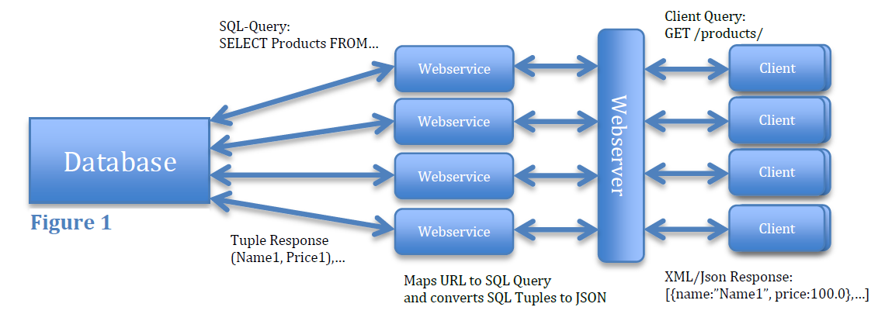
OData (revisited)
Web protocol for querying and updating data
Access database over HTTP
Returns query results as JSON

Slide 3
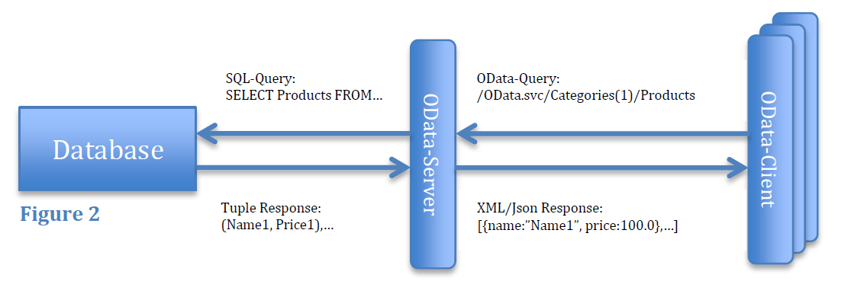
OData (revisited)
Web protocol for querying and updating data
Access database over HTTP
Returns query results as JSON

Slide 4
OData Business Context
ODataERP Stack
Data Overhead/Performance
Application state
Security/Encryption
OData for HPAs
Ideas for improvement

Slide 5
ODataERP Stack
1100 LOC
Serves static files
Handles Communication
Client
Server
jQuery.js
app.js
ASP.NET
OData.svc
jQueryUI.js
datajs.js
MSSQL Server
Stored procedures
DataTables.js

Slide 6
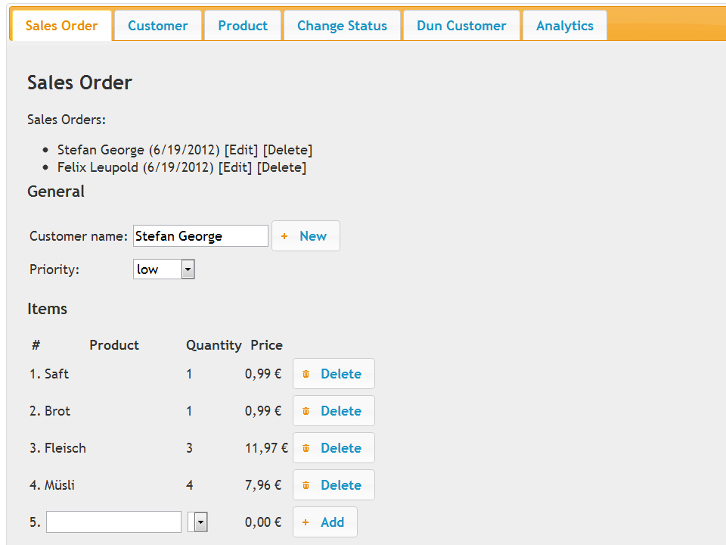
App Screenshot

Slide 7
Data Overhead/Performance
JSON better than Atom
JSON format
URL for foreign keys
Property names for each entry
Notes:
Odata Consortium fragt sich: Wie kann man das verbessern
1 mal Metainformation: danach nur noch die values. Immernoch json

Slide 8
Application state
Complete asynchronous communication
Only one URL
Client
Transaction State
Form State
Authentication State
Server
Session ID
Notes:
Rich Client Anwendung
Authentication auf beiden
Keine Transaktionssicherheit
Internetconnection Lost -> halbe Salesorder
Wegen Async REST -> kein Aufschluss über URL (1 Seite)

Slide 9
Security/Encryption
DOS Attacken
ODataERP.svc/Customer?$top=100000000$expand=Orders
Limit range of possible selections
Limit execution time on data base layer
No encryption in OData:
Use HTTPS
Authorization on entity level:
config.SetEntitySetAccessRule("*", EntitySetRights.All);
No authentication in OData
Authentication on a different layer (e.g. using OAuth)
Notes:
Alle customer mit allen orders -> verlangsamt das system
Keine Hilfe von Microsoft -> Range limit, limit execution time
Wenn solche anfragen kommen immer angriff
Keine Authorization auf Attributebene -> Views
Authentication mit Oauth (kompliziert)

Slide 10
HPAs
OData in context of High Performance Applications
Modern HTML5 web applications
Most of the code is JavaScript (90%)
Using OData for communication
HANA OData Server available
Great for read access
Bad for writing access
Notes:
HPA in Banken um Cacheflow zu analysieren
Odata bereits angewendet
geschwätzig

Slide 11
Ideas
360/1100 = 32% LOC OData Service Functions
Idea: OData ORM for JavaScript
Shorter syntax
Easier to express object creation
Explore Service automatically
Auto completion
Easier to read

Slide 12
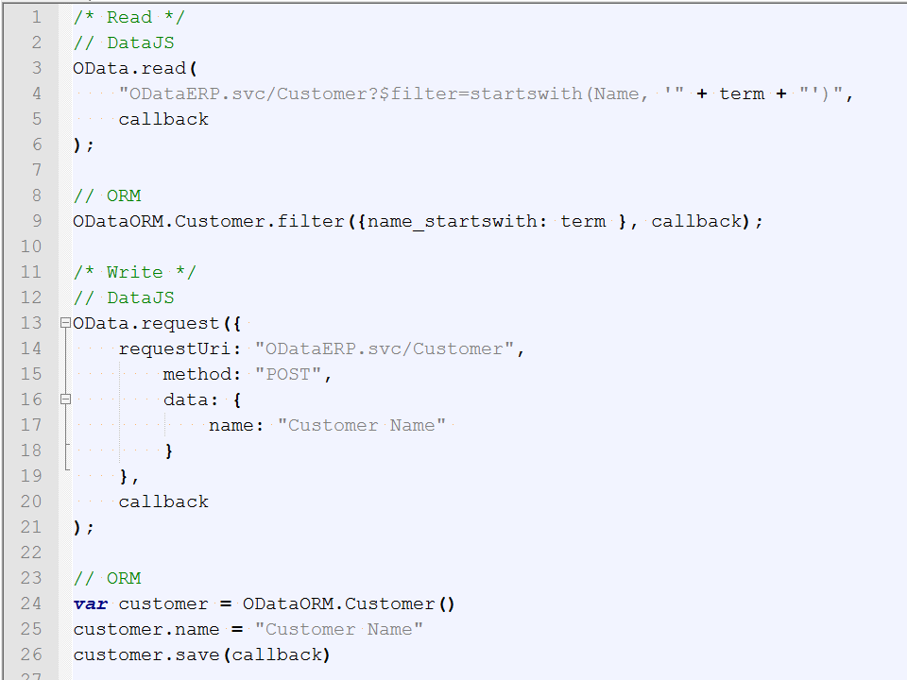

Slide 13
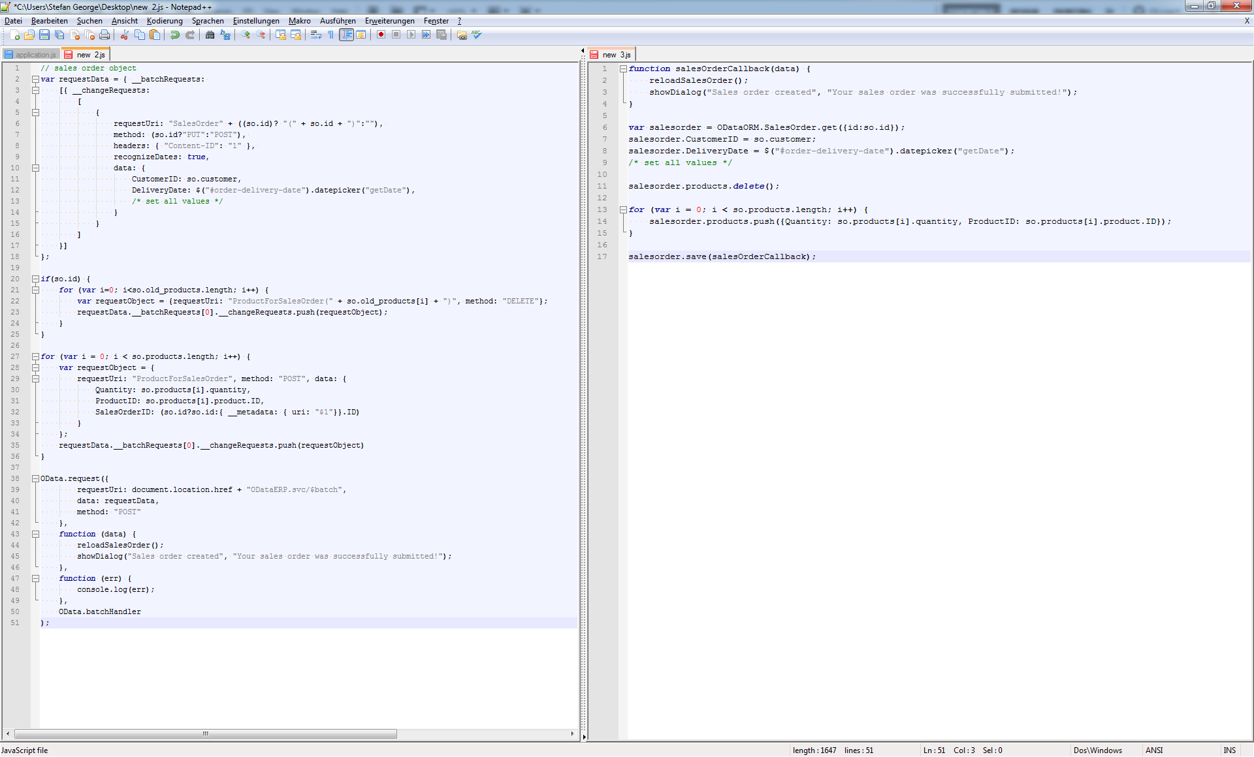

Slide 14
Conclusion
OData is great for exposing data for reading access
Expressive filter syntax
OData is great for smaller analytics/publishing apps
Application server can be crated automatically
Logic lies in Database and JavaScript
One layer of complexity removed
Some security & application state issues in business context
DOS
Transaction State
Notes:
Next Steps
Wie weit ist der Prozess implementiert

